Slide 1
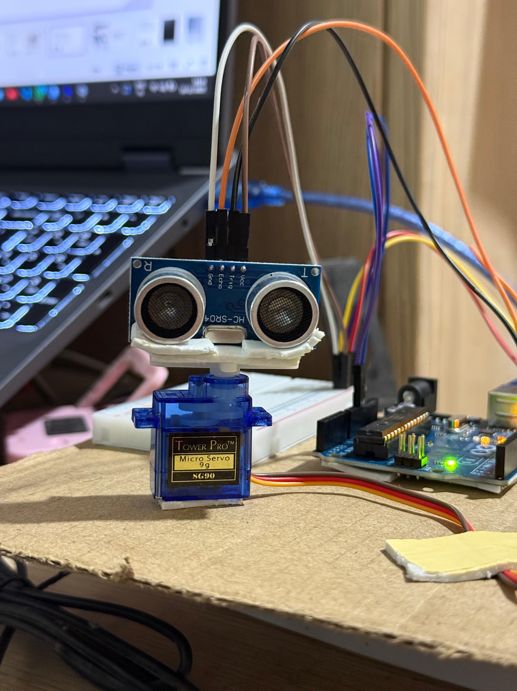

2025-11-16
Introduction to DIY Technology
Arduino-Based Radar System

Slide 2

Introduction
Exploring Real-Time Object Detection with Arduino
This presentation introduces a DIY Arduino radar detection system utilizing an ultrasonic sensor to monitor surroundings, providing engaging insights into object detection and visualization techniques.

Slide 3
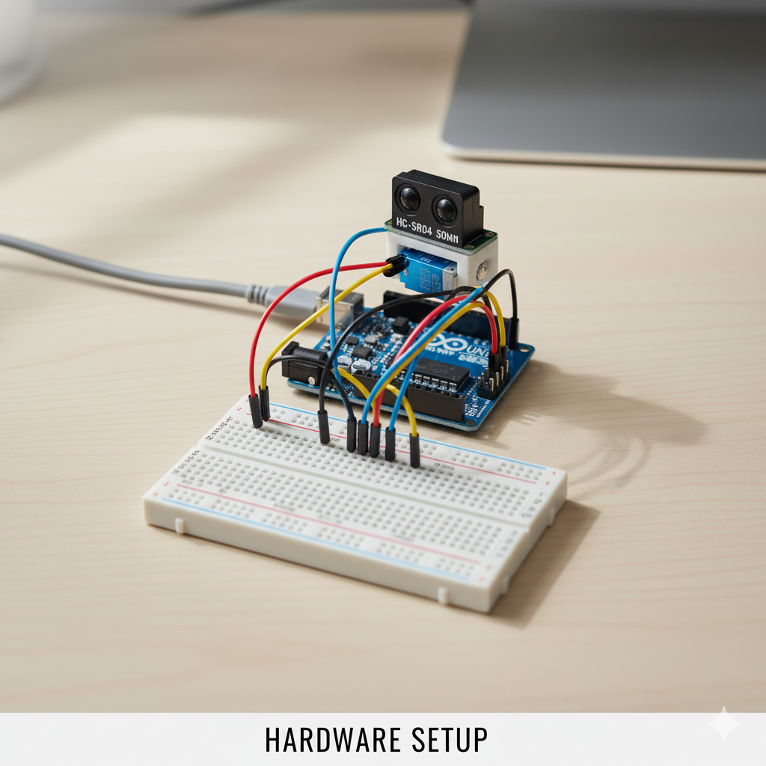
The system functions by scanning surroundings, measuring distances, and visualizing data in real-time. The ultrasonic sensor emits pulses, enabling the Arduino to detect and display objects effectively.

Slide 4
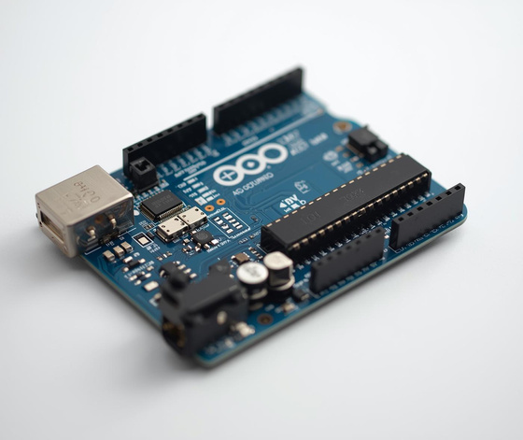
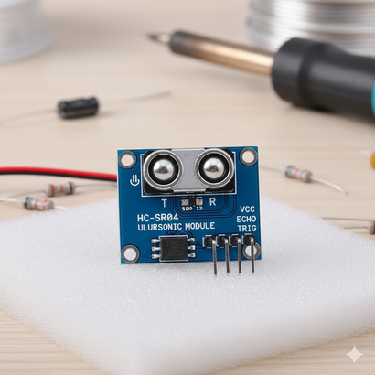
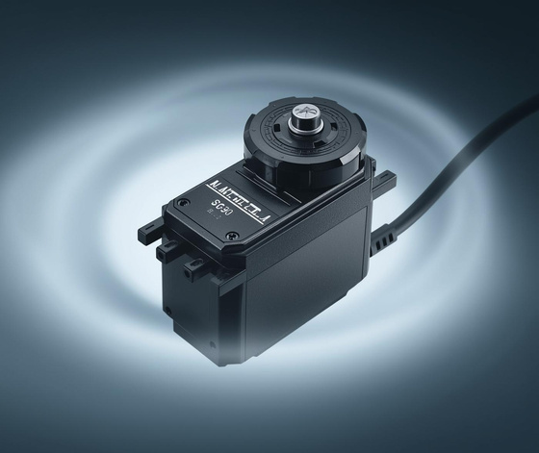

Essential Hardware and Software Components
Arduino Uno
ultra sonic sensor
Servo Motor
The main controller for all system operations.
Measures distance using ultrasonic pulses effectively.
Rotates sensor for comprehensive scanning capabilities.

Slide 5
Mounting the Ultrasonic Sensor
Assembling the components accurately
Proper mounting is essential for effective scanning. Ensure stability.

Slide 6

Arduino Code for Servo Control
To achieve the radar functionality, the Arduino programming involves the following key steps:
Include necessary libraries for servo and ultrasonic sensor.
Set up pin assignments for servo and sensor.
Create a loop to rotate the servo from 0° to 180° and back.
Emit ultrasonic pulses to measure distance.
Calculate and send distance data via serial communication.

Slide 7
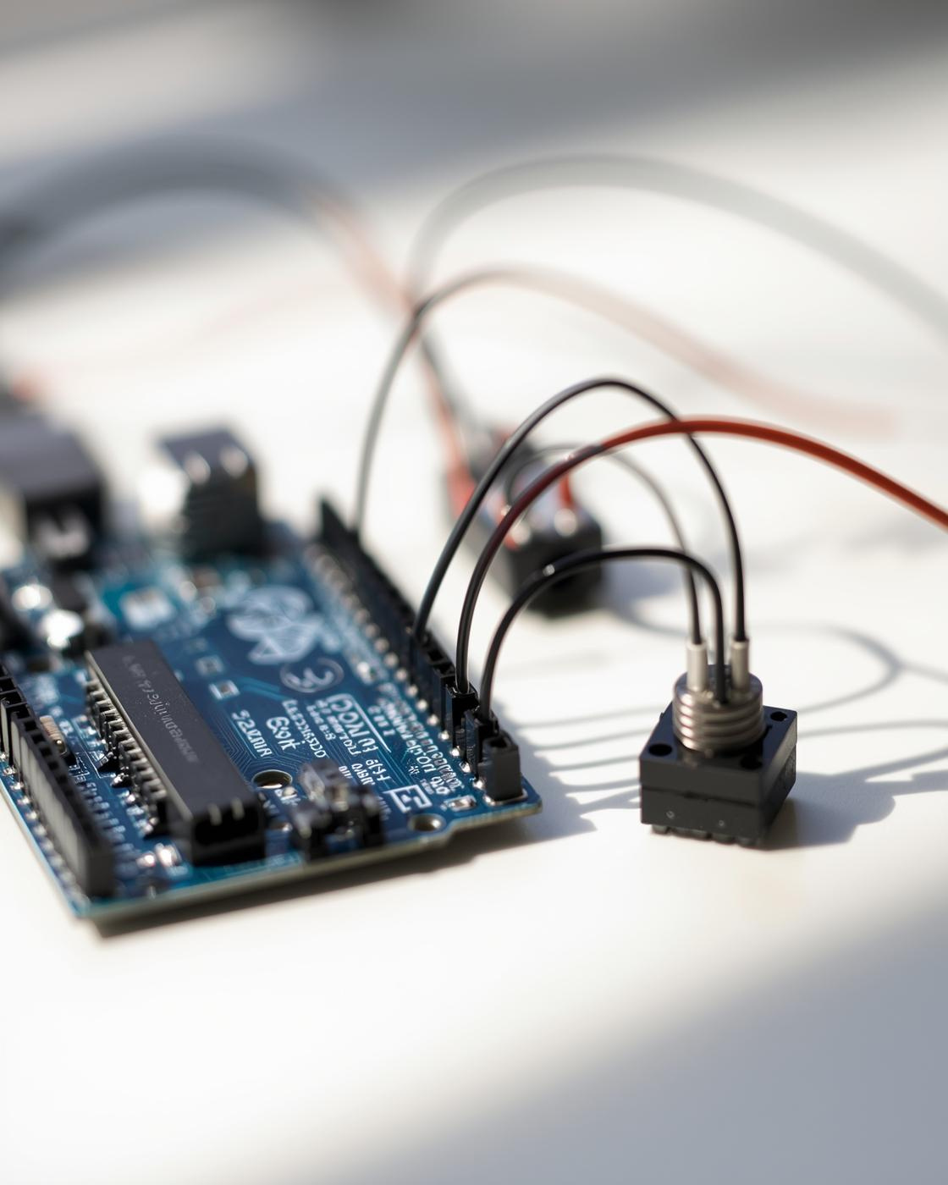
The Arduino sketch calculates distance using the formula based on echo time and sends this data via serial communication, enabling real-time visualization in Processing software.

Slide 8
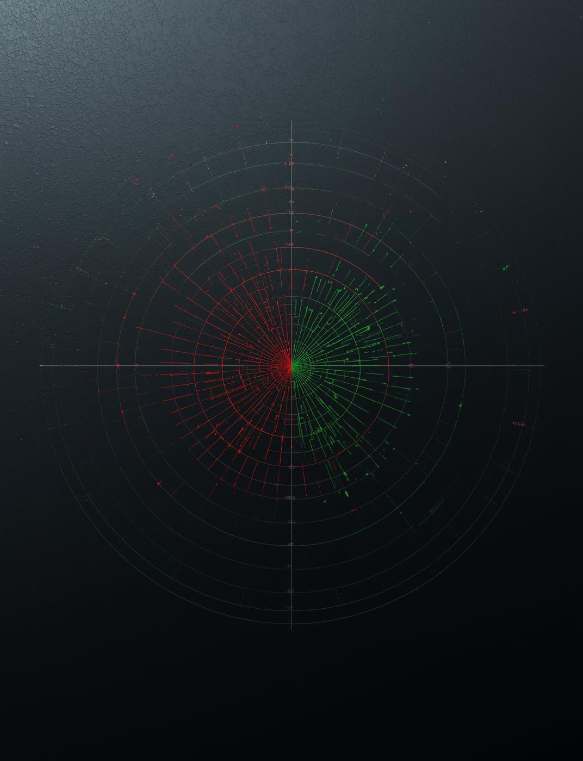
Real-Time Visualization
The Processing software reads data continuously, dynamically updating radar lines to indicate detected objects and clear areas.

Slide 9
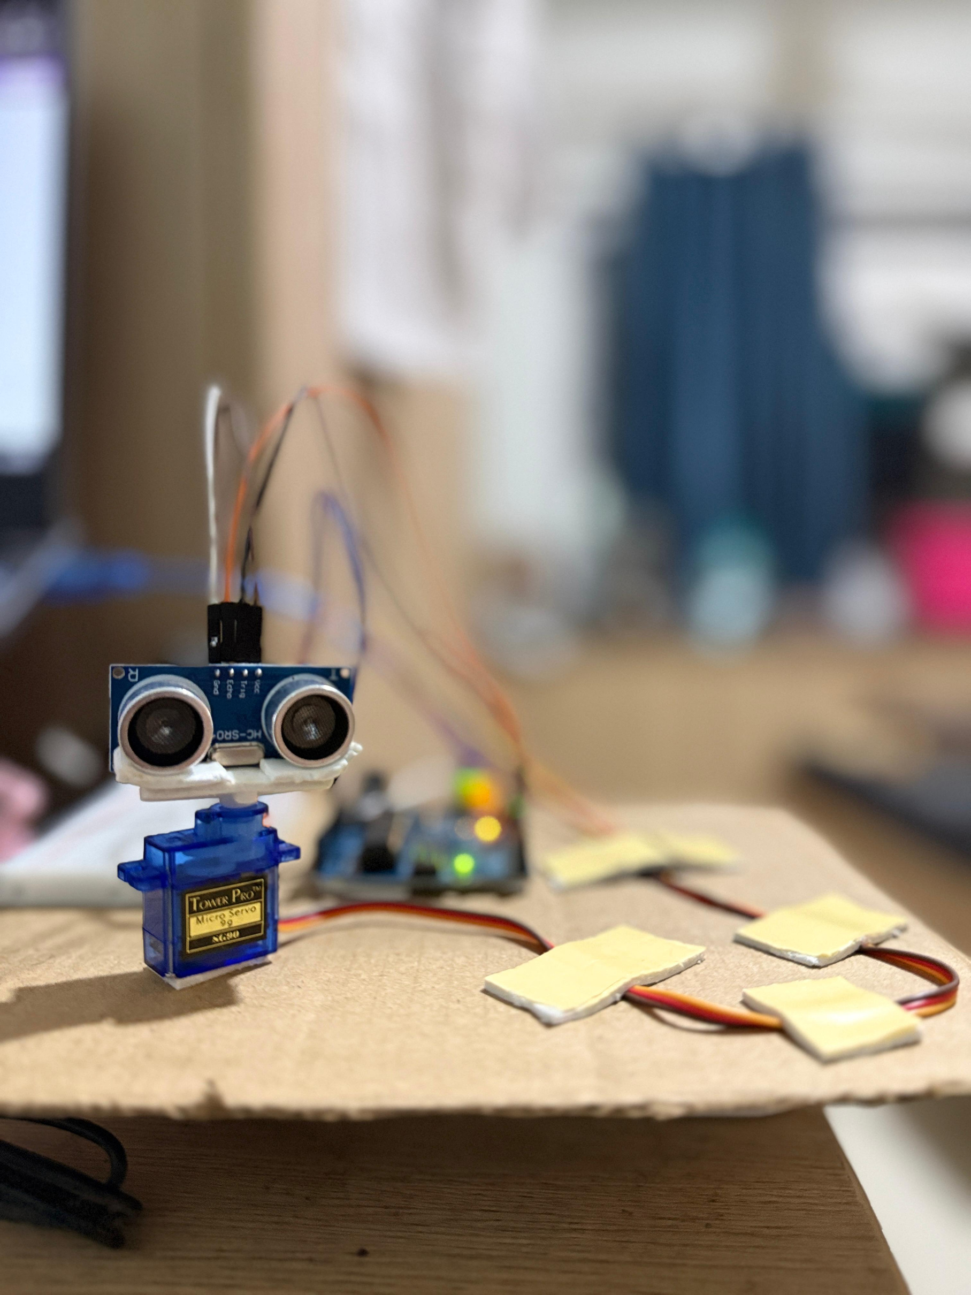
The data flow from Arduino to Processing involves serial communication, enabling real-time visualization of distance measurements and object detection through the radar-like display.

Slide 10
Educational Value of Arduino
01
STEM Learning
Engages students in hands-on projects and real-world applications.
02
Programming Skills
Develops coding abilities through Arduino IDE and Processing software.
03
Data Visualization
Teaches data representation concepts using dynamic radar displays.

Slide 11
Practical Applications
01
Robotics
Enables obstacle detection and navigation for autonomous systems.
02
Automation
Acts as a proximity sensor for smart home devices.
03
Security
Monitors motion and area for enhanced safety systems.

Slide 12
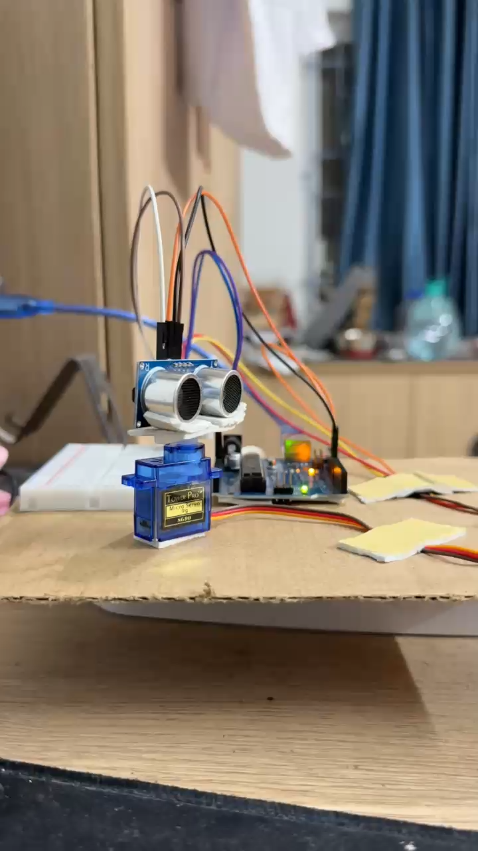
Conclusion
The Arduino radar system is both accessible and practical, providing valuable educational experiences for all ages.

Slide 13
Thank You!
Team name
Team Cryptosolve
Team members
Aaditya Anand (RA2511003011540)
Kushagra Srivastava (RA2511003011590)
Rudra Pratap Singh (RA2511003011539)
Satviik Daga (RA2511003011550)
Uzair Sikwani (RA2511003011543)

